Slide 1


Connecting in the Facebook Age:
Development and
Validation of a New Measure of Relationship Maintenance
Norrebo
Jessica Vitak
College of Information Studies, University of Maryland
jvitak@umd.edu | @jvitak

Slide 2

Why relationship maintenance matters
Flickr: Photos_by_Lis

Slide 3

Measuring relationship maintenance
Driven by Stafford & Canary’s (1991) research
on married couples’ relationships.
Linked engagement in strategies to:
  Commitment to partner
  Mutual liking
  Relational satisfaction
Flickr: chicks57

Slide 4
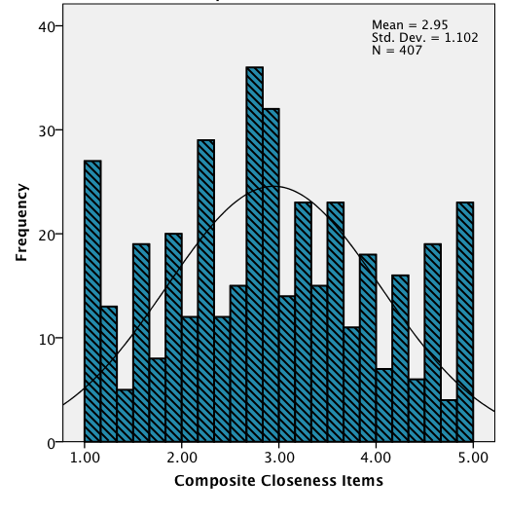
What’s wrong with existing measures?
Major weakness of relationship maintenance research is its focus on strong-tie relationships and collocation.
Many Facebook relationships are weak ties or geographically distant.
Old measures do not account for affordances of new communication technologies.
Dibble et al. (2012)
Unidimensional Relationship Closeness Scale

Slide 5
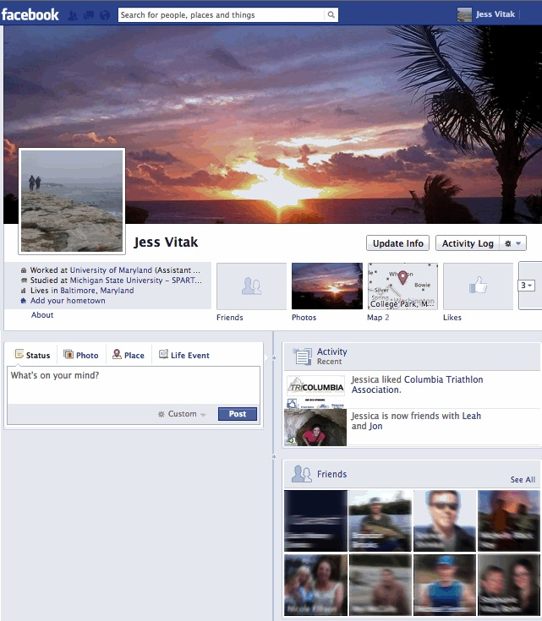
Method
3000 non-faculty MSU staff were invited to complete an online survey on their Facebook use (415 responses).
Participants logged into site, went to their profile and selected Friend in top left position.
They then entered name of person into a survey field.
Questions were tailored to the selected Friend (e.g., “I use Facebook to get to know John better”).
Facebook Profile Layout
October 2012
Notes:
Sample of 3000 MSU staff invited; 415 completed survey. Requirement of having a Facebook account lowered the response rate.
Asked them about the various behaviors they performed, directly or indirectly, that could represent a form of relationship maintenance.
Also asked them about relational closeness, perceived access to resources, general communication patterns.

Slide 6
Devising a new measure of relationship maintenance
Inventory of 58 behavioral items
Exploratory factor analysis (EFA)
  Principal components analysis
  Promax rotation
  35 items removed
  4-factor solution explained 60.9% of variance
  Confirmed via scree test (Cattell, 1966) and parallel analysis (Horn, 1965)
Notes:
Used SPSS syntax script to run parallel analysis. This confirmed a four-factor solution.
1000 dataset were generated.
Principal axis and maximum likelihood extra were tested; however, solutions they provided were in line with promax
-------
PA Explained:
Parallel Analysis takes a different approach, and is based on the Monte Carlo simulation. A data set, having the same sample size and number of variables, but containing random numbers, are subjected to analysis, and the Eigen values obtained are recorded. This is repeated many times (the common recommendations are between 50 and 100 replications, although 1000 times have been suggested). The Eigen values for each component, obtained from many replications, are used to calculate means and Standard Deviations, from these the 95 percentile values are obtained (95 percentile = mean + 1.65SD). These are the Eigen Values obtained from random numbers, and forms the standard against which the Eigen values of each component from the research data is matched. Components are retained if its Eigen value exceeds the 95 percentile of the simulated values. The argument being that this variance is greater than that obtained at random.

Slide 7
Relationship Maintenance Constructs
Supportive Communication (7 items, M=3.68, SD=.82, α=.88)
  Indicative of social grooming.
  Items capture tone of interaction and provisions of support.
Sample Items
  My Facebook interactions with (person) are generally positive.
  When I see (person) sharing good news on Facebook, I'll like his/her update.
  I make sure to send (person) a note (wall post, comment, private message, etc.) on his/her birthday.

Slide 8
Relationship Maintenance Constructs
Shared Interests (7 items, M=2.33, SD=.88, α=.87)
  Interactions that highlight common ground between partners.
Sample Items
  “When I see something online that I think (person) would find interesting, I'll send him/her a note about it on Facebook.”
  “I share links with (person’s name) on Facebook.”
  “(Person) and I use Facebook to coordinate events related to a shared interest, sport, and/or hobby.”
Notes:
Social Support was Positive Communication
Social Information Seeking was Social Communication

Slide 9
Relationship Maintenance Constructs
Passive Browsing (4 items, M=2.91, SD=.89, α=.85)
  Low-cost way to keep up-to-date on others’ lives without direct interaction.
Sample Items
  “Estimate the frequency with which you browse his/her photo albums.”
  “I browse through (person’s name)’s profile page to see what he/she's been doing.”
Notes:
Social Support was Positive Communication
Social Information Seeking was Social Communication

Slide 10
Relationship Maintenance Constructs
Social Information Seeking (5 items, M=2.73, SD=.86, α=.79)
  “Use of the site for learning more about people with whom the user has some offline connection” (Ellison et al., 2011).
  Using the site to track others’ everyday activities as well as learn new things about them.
Sample Items
  “I use Facebook to get to know (person) better.”
  “I keep up to date on (person)'s day-to-day activities through Facebook.”
  “I use Facebook to find out things person and I have in common.”
Notes:
Social Support was Positive Communication
Social Information Seeking was Social Communication
Questions cut in CFA:
[question(value), id=4] posts updates to Facebook about his/her day-to-day activities
I learn about big news in (person)’s life from Facebook.

Slide 11
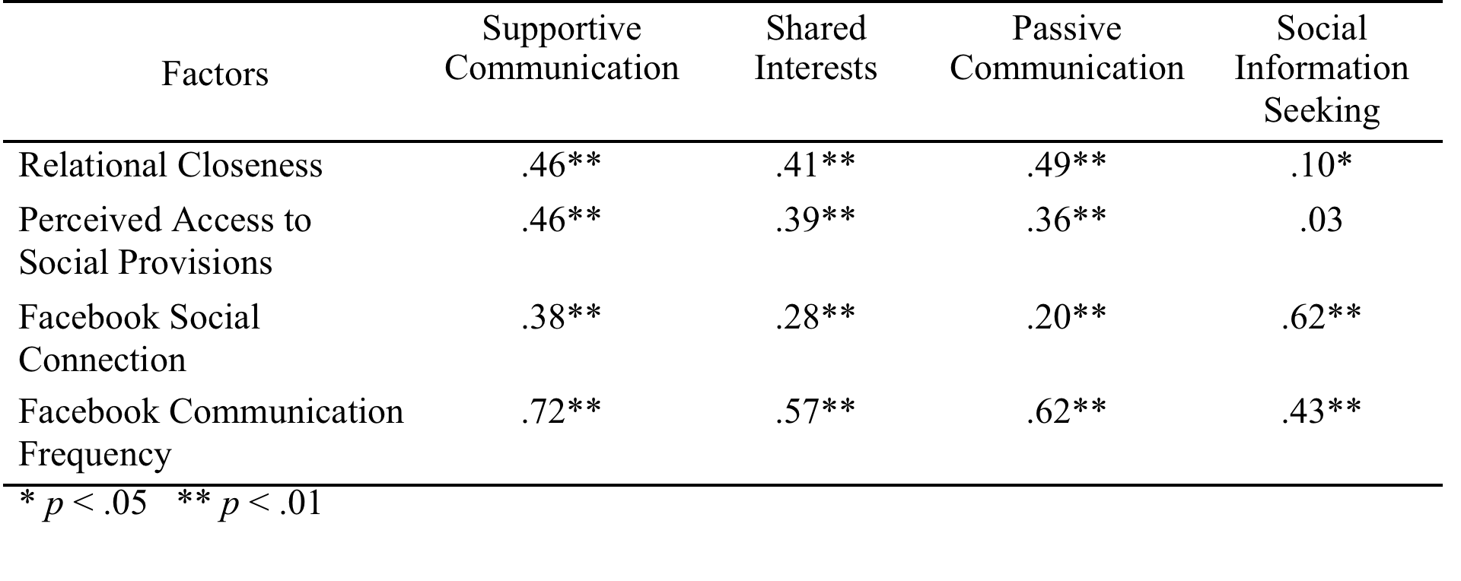
Convergent validity testing
Variable Notes:
Relational Closeness – see Dibble, Levine & Park (2012)
Perceived access to social provisions -- see Cutrona & Russell’s (1986) Social Provisions scales
Facebook Social Connection— see Ledbetter (2009)
Facebook Communication Frequency — wall posts, comments, Likes with Friend
Notes:
Convergent validity assesses the extent to which two measures that should theoretically be related are actually related.
Relational closeness: The extent to which two people feel emotionally connected is generally correlated with engagement in relationship maintenance strategies
Perceived access to social provisions: two of these subscales tap specifically into the emotional and instrumental support that members of one’s social network may provide: Guidance measures the degree to which a person feels s/he has people to turn to for advice, while Reliable Alliance assesses whether the person believes someone will provide him/her with tangible assistance when needed.
Facebook Social Connection: This scale adapts Ledbetter’s (2009) validated Online Social Connection measure and “represents the extent to which an individual believes that online communication is an important part of that individual’s social life.”

Slide 12
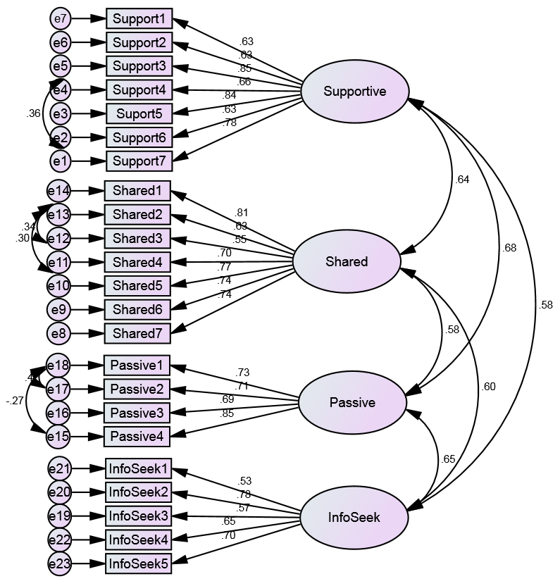
Confirmatory factor analysis
Original model (23 items):
Metric
  CMIN: 2.367
  RMR: .069
  CFI: .937
  GFI: .894
  RMSEA: .058
Notes:
CMIN/DF, which is the chi-square divided by the df value, should ideally be less than 2.0
The root mean square residual (RMR) and standardized root mean square residual (SRMR) are the square root of the discrepancy between the sample covariance matrix and the model covariance matrix.
RMSEA, which denotes root mean square of the residuals, should be less than 0.05
The comparative fit index (CFI) analyzes the model fit by examining the discrepancy between the data and the hypothesized model, while adjusting for the issues of sample size inherent in the chi-squared test of model fit and the normed fit index
The goodness of fit index (GFI) is a measure of fit between the hypothesized model and the observed covariance matrix. The adjusted goodness of fit index (AGFI) corrects the GFI, which is affected by the number of indicators of each latent variable.

Slide 13
Confirmatory factor analysis
Original model (23 items):
Metric Thres.
  CMIN: 2.367 <3
  RMR: .069 <.08
  CFI: .937 >.90
  GFI: .894 >.90
  RMSEA: .058 <.08
Notes:
CMIN/DF, which is the chi-square divided by the df value, should ideally be less than 2.0
The root mean square residual (RMR) and standardized root mean square residual (SRMR) are the square root of the discrepancy between the sample covariance matrix and the model covariance matrix.
RMSEA, which denotes root mean square of the residuals, should be less than 0.05
The comparative fit index (CFI) analyzes the model fit by examining the discrepancy between the data and the hypothesized model, while adjusting for the issues of sample size inherent in the chi-squared test of model fit and the normed fit index
The goodness of fit index (GFI) is a measure of fit between the hypothesized model and the observed covariance matrix. The adjusted goodness of fit index (AGFI) corrects the GFI, which is affected by the number of indicators of each latent variable.

Slide 14
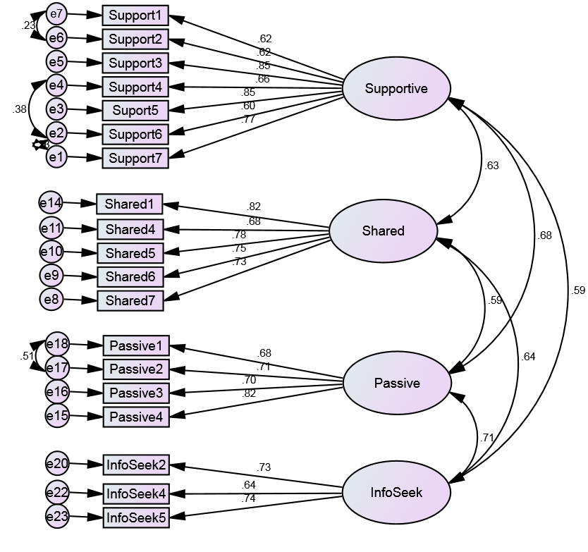
Confirmatory factor analysis
Revised model (19 items):
Metric Thres.
  CMIN: 1.977 <3
  RMR: .058 <.08
  CFI: .965 >.90
  GFI: .931 >.90
  RMSEA: .049 <.08
Notes:
CMIN/DF, which is the chi-square divided by the df value, should ideally be less than 2.0
The root mean square residual (RMR) and standardized root mean square residual (SRMR) are the square root of the discrepancy between the sample covariance matrix and the model covariance matrix.
RMSEA, which denotes root mean square of the residuals, should be less than 0.05
The comparative fit index (CFI) analyzes the model fit by examining the discrepancy between the data and the hypothesized model, while adjusting for the issues of sample size inherent in the chi-squared test of model fit and the normed fit index
The goodness of fit index (GFI) is a measure of fit between the hypothesized model and the observed covariance matrix. The adjusted goodness of fit index (AGFI) corrects the GFI, which is affected by the number of indicators of each latent variable.

Slide 15
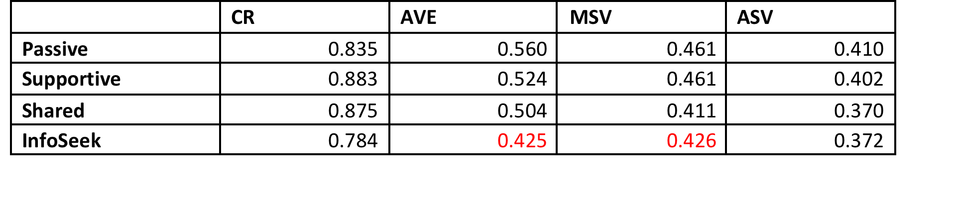
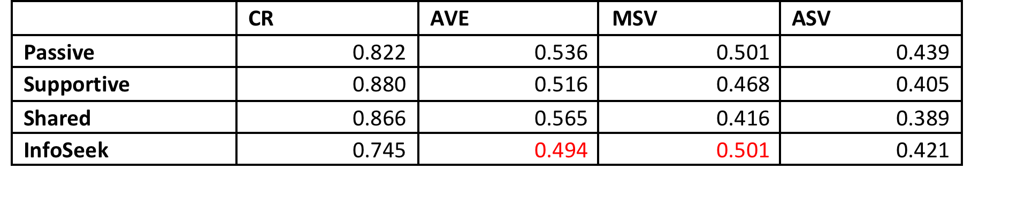
Internal reliability & validity
Full 23-item measure
Adjusted 19-item measure
Notes:
CR=Composite Reliability
AVE=Average Variance Extracted
MSV=Maximum Shared Variance
ASV=Average Shared Variance
Thresholds:
Reliability: CR > .7
Convergent Validity: CR>AVE; AVE>.5
Discriminant Validity: MSV<AVE; ASV<AVE
Notes:
If you have convergent validity issues, then your variables do not correlate well with each other within their parent factor; i.e, the latent factor is not well explained by its observed variables.
If you have discriminant validity issues, then your variables correlate more highly with variables outside their parent factor than with the variables within their parent factor; i.e., the latent factor is better explained by some other variables (from a different factor), than by its own observed variables.

Slide 16
Next Steps
Retest 23-item relationship maintenance strategies measure with new sample to further establish validity.
Include additional items that tap into underlying constructs of Social Information Seeking subscale.
Also collect data on engagement in Stafford & Canary’s relationship maintenance items.
Compare scales’ predictive ability against relational outcomes to establish concurrent validity.
Notes:
Concurrent validity is a type of evidence that can be gathered to defend the use of a test for predicting other outcomes. It is a parameter used in sociology, psychology, and other psychometric or behavioral sciences. Concurrent validity is demonstrated when a test correlates well with a measure that has previously been validated.

Slide 17

Why is this measure important?
CMC facilitates relationship maintenance among various ties.
CMC researchers need valid and reliable measures accounting for affordances of these technologies.
Additional analyses revealed that engagement in these strategies is associated with relational benefits and that these benefits vary by relational type.

Slide 18
“I suspect that Facebook’s one great contribution has been to slow down that rate of relationship decay by allowing us to keep in touch with friends over long distances.”
--Robin Dunbar
Thanks!
Jessica Vitak
College of Information Studies, University of Maryland
jvitak@umd.edu | Twitter: @jvitak
Find this paper at jessicavitak.com/cv
This study was funded through a research grant from the College of Communication Arts & Sciences at Michigan State University.

